Slide 1





Upgrade and consolidation of post‑trade infrastructure in Ukraine
Implementation plan
(jointly developed by NSSMC, NDU, NBU and the Settlement Center
with consultation from EBRD and Oliver Wyman)
Stakeholder Workshop #3
31 May 2017

Slide 2
Objectives of today’s meeting
Jointly recap the target set-up
Provide update on overall progress since last workshop (NSSMC)
Present and align on detailed implementation plans developed by four institutions with consultation from EBRD and Oliver Wyman (work block leads)
Discuss next steps

Slide 3
1
Recap: Target set-up

Slide 4
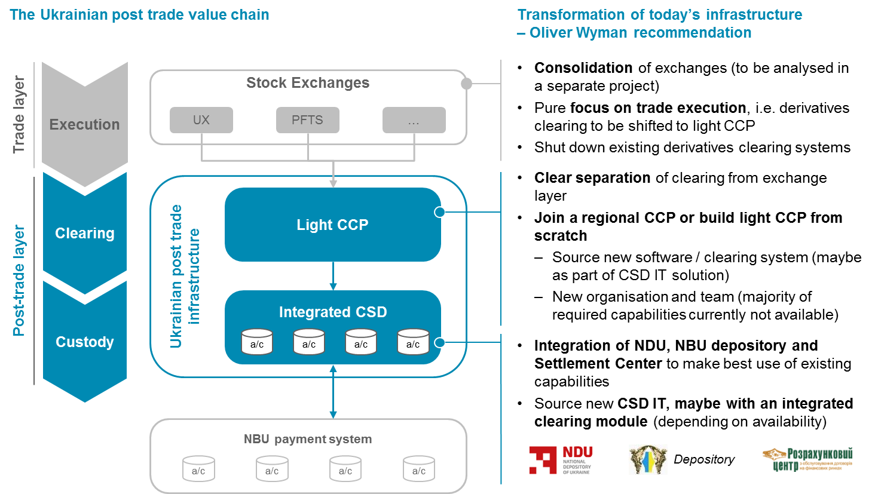
Oliver Wyman recommends to follow a clean-slate approach for the clearing layer implementation

Slide 5
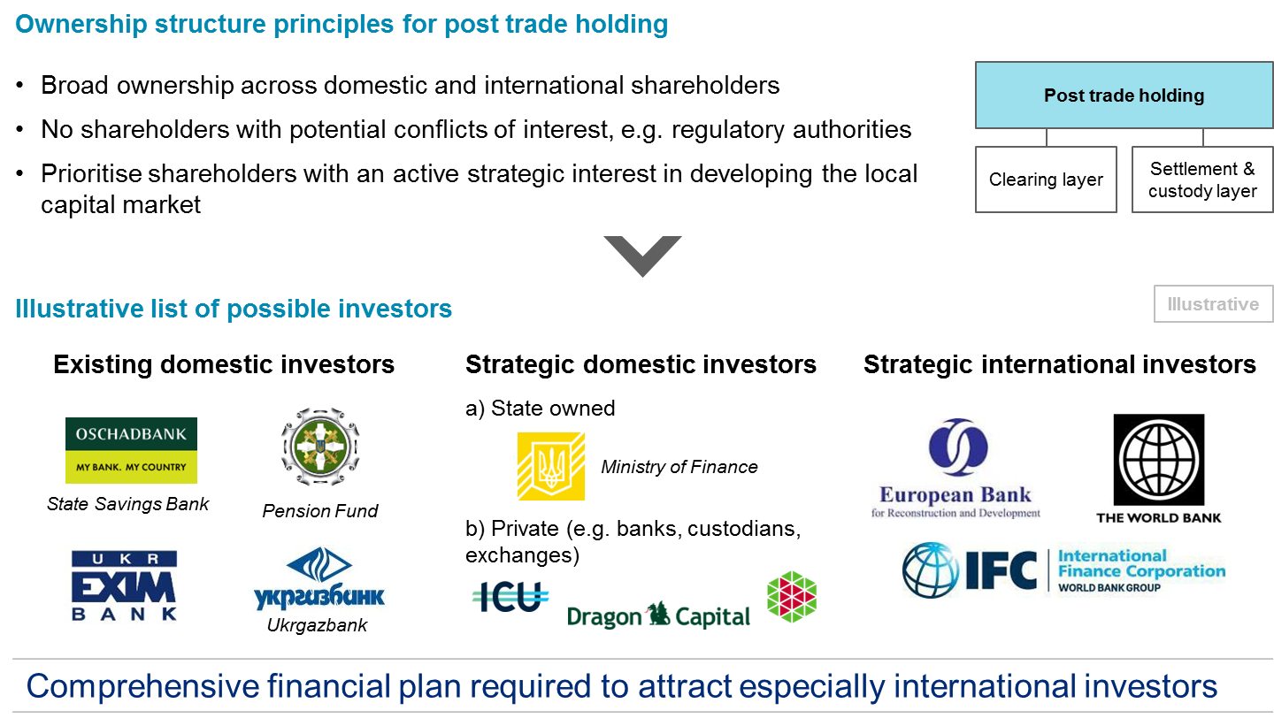
Funding of the transformation and long term development should be provided by a revised ownership structure with strategic interests

Slide 6
2
Implementation plan overview

Slide 7
For the transformation program, four major work blocks were identified
Work block | Activities
Transformation ramp-up | Transition: stakeholder buy-in, program governance, handover
A. Post trade corporate finance, governance & organisation | Corporate Finance: Financial plan, investor acquisition, negotiation with exchanges, ownership structure
 | Governance & top level organisation: Post trade holding governance and leadership
B. Light CCP operating model implementation | Concept specification: System requirements, detailing of outlined target concept
 | IT: Vendor selection process (see CSD IT)
 | Operations & processes: Risk management processes, workflow determination
 | Organisational set-up: Teams, positions, roles & responsibilities
 | Pricing
 | Risk analysis & IT: Clearing engine and risk models, algorithms, implementation
C. Integrated CSD operating model implementation | IT: Vendor selection process, implementation of new platform, testing and refinement
 | Operations & processes: Business process analysis / optimisation / process documentation
 | Organisational set-up: Teams, positions, roles & responsibilities
 | Pricing
 | Transfer of assets onto new platform
D. Implementation support | HR: FTE / capability mapping, gap and overlap identification, recruiting, lay-offs
 | Communication: Participant information, official market communication

Slide 8
Overall transformation is expected to take 18-21 months with a go-live of the new post trade set-up in 01/2019
Updated in May 2017, based on feedback from work block leads
2017
2018
2019
Work blocks
 | Transformation program ramp-up
A | Post trade corporate finance, governance & organisation
B | Light CCP operating model implementation
C | Integrated CSD operating model implementation
D | Implementation support
Con-
cept
Impl. prep.
Program
kick-off
Ownership structure
Post trade governance finalised
New ownership structure implemented
Fin.
plan
Investor acquisition
Holding govern. & top level org.
Implementation of new
ownership structure
Negotiation
with exchanges
Concept specification
Operations & processes
Org. set-up
Pricing
Go-live of light CCP
IT: vendor selection
process (see CSD IT)
Risk analysis and IT , incl. im-
plementation (linked with CSD IT)
Testing and refinement
Operations & processes
Org. set-up
Pricing
Go-live of new integrated CSD
Transfer of
assets, start with
NDU then gov.
bonds from NBU
IT: vendor
selection process
IT: implementation of platform
Testing and refinement
HR: FTE / capability mapping, gap and
overlap identification, recruiting, lay-offs
Transformation completed
Participant information
Official market Communication
New organisation fully staffed
Phase C
Transformation board meetings
monthly progress reports
Completion/ major milestone
Dependencies

Slide 9

A Transformation Board should be introduced to maintain oversight, and coordinate with the program lead who drives the overall progress
Proposed transformation program governance
Description
Transformation Board
  Decision-making body on project related topics
  Review and confirmation of project results
- Local stakeholders and major investors-
Program lead
  Control over the overall program
  Coordination of work blocks
Dmytro Tarabakin
(Max Libanov)
PMO
  Process-related support of the program and project managers and develop-ment of program structures and plans
  Scope management and “gate-keeping“
  Temporary set-up support / start-up grant
  Production of project results, decision memos, presentations and documentation
A
B
C
D
Post trade corporate finance, governance & organisation
Light CCP
operating model implementation
Integrated CSD operating model implementation
Implementation support
Mindaugas Bakas (Yuriy Shapoval, Iryna Gnatyuk, Andriy Suprun, Mykola Selekhman, Alla Papaika)
Yuriy Shapoval (Mindaugas Bakas, Iryna Kurochkina, Mykola Selekhman)
Mindaugas Bakas (Andriy Suprun, Yuriy Shapoval, Iryna Gnatyuk, Iryna Omelchenko)
  Development of project results
  Responsibility for the projects and fulfilment of the project goals and milestones
- Tbd -
Set-up = Lead (Team)

Slide 10
3
Detailed work block plans
Updated in May 2017, based on feedback from work block leads

Slide 11
Block A: Post trade corporate finance, governance & organisation (1/2)
Detailed timeline
Updated in May 2017, based on feedback from work block leads
A | B | C | D
 |  |  | 2017 |  |  |  |  |  |  |  |  |  |  |  | 2018 |  |  |  |  |  |  |  |  |  |  |  | 2019
 |  |  | Q1 |  |  | Q2 |  |  | Q3 |  |  | Q4 |  |  | Q1 |  |  | Q2 |  |  | Q3 |  |  | Q4 |  |  | Q1 |  |  | Q2
Activities
1 | Corporate Finance
 | Financial plan
 | Investor acquisition
 | Negotiation with exchanges
2 | Holding governance and top level organisation
Key meetings/ workshops
 | Governance and leadership workshop
Key milestones
 | Light CCP impl. approach determined
 | Holding governance determined
 | Ownership structure defined
 | New ownership structure implemented

Slide 12
Post trade corporate finance, governance & organisation (2/2)
Key activities, dependencies and risks
Updated in May 2017, based on feedback from work block leads
A | B | C | D
Activity
Description
Dependencies
& risks
Responsibilities
Corporate Finance
1
Development of financial plan – use conservative assumptions
Required investments
Operational cash-flow from core business (revenues / costs)
Projections for future profitability
Pay-back period / break even
Real Estate @ RC
Forecasting future business
Mindaugas
Yuriy
Dmytro
Andriy
Acquisition of investors, based on financial plan
Investment from Ministry of Finance
Pitch to strategic investors (domestic & international)
Limitations in legislation to change ownership
Dependent on Financial Plan
Dmytro
Mindaugas
Yuriy
Negotiation with exchanges
Clearing mandate for the Ukrainian market
Implications on shareholder structure
Dependent on parallel EBRD project and Financial plan
2
Develop governance principles for holding
Determine positions and potential composition of leadership roles in future post trade entities
Finalise and agree with new shareholders in a dedicated workshop
Political decision from shareholders and other stakeholders
Holding
governance
and top level organisation
Dmytro
Alla
Mindaugas
Andriy

Slide 13
Comments to block A
Updated in May 2017, based on feedback from work block leads
A | B | C | D
Financial plan
  Forecasting while expecting dramatic changes in business model and environment for CCP and CSD is extremely complicated and result can be easily challenged by potential investors
  Real estate that makes large part of CCP capital has to be removed form balance eventually, though this process can run in parallel and should not implicate the overall reorganization
    The process of real estate removal should be reflected within financial plan to provide investors with sufficient information
Investor acquisition
  Extension of allocated time until second half of 2018: Current laws prescribe the limitations to the ownership structure of CSD and CCP. Real negotiations on investor acquisition can be resumed after laws are passed or passed first hearing (?)
Ownership model
  The final model of holding depends on political decisions on the level of Commission, NBU, Ministry of Finance, other
    This will take many meetings and discussions, thus it will take a lot more time than a month
  Actual implementation of new ownership structure will be possible only after the changes in the regulation, i.e. not earlier than end of 2018

Slide 14
Light CCP operating model implementation (1/3)
Detailed timeline
A | B | C | D
 |  |  | 2017 |  |  |  |  |  |  |  |  |  |  |  | 2018 |  |  |  |  |  |  |  |  |  |  |  | 2019
 |  |  | Q1 |  |  | Q2 |  |  | Q3 |  |  | Q4 |  |  | Q1 |  |  | Q2 |  |  | Q3 |  |  | Q4 |  |  | Q1 |  |  | Q2
Activities
1 | Concept specification
2 | IT: Vendor selection (see CSD IT)
3 | Operations & processes
4 | Organizational set-up
5 | Pricing
6 | Risk analysis and IT
 | Risk calculation logic for Ukraine
 | IT implementation
7 | Testing and refinement
Key meetings/ workshops
 | Vendor selection workshop
 | Workshops with vendor
Key milestones
 | Light CCP impl. approach determined
 | UA-specific clearing module impl.
 | Go-live of light CCP

Slide 15
Light CCP operating model implementation (2/3)
Key activities, dependencies and risks
A | B | C | D
Activity
Description
Dependencies
& risks
Responsibilities
1
Tbd
Concept
specification
Translate target concept into system requirements (for integration in CSD RfP, or separate RfP)
Elaborate on detailed technical questions (e.g. own funds of CCP to be ring fenced in default waterfall)
Tbd (ideally on name basis)
IT:
Vendor selection
See CSD IT vendor selection for integrated solution
Alternatively, run separate RfP process and select vendor
Tbd
Tbd (ideally on name basis)
2
Operations & processes
Determine clearing and risk management operations
Define processes including documentation
Determine Service Level Agreements
3
Tbd
Tbd
Organizational
set-up
Derive required number of FTE to perform operations
Design organisational set-up based on core activities, taking spans & layers considerations into account
Tbd
4
Pricing
5
Develop principles for light CCP pricing
Derive light CCP pricing schedule so that clearing core business can be self sufficient
Tbd

Slide 16
Light CCP operating model implementation (3/3)
Key activities, dependencies and risks
A | B | C | D
Activity
Description
Dependencies
& risks
Responsibilities
Risk analysis and IT
Determine risk calculation logic for Ukraine, incl. risk parameters, confidence levels, potential liquidity surcharges, liquidity threshold for light CCP clearing vs. pre-funding etc.
Tbd
Tbd
6
Implement Clearing System and link with CSD and exchanges
Adopt risk calculation logic for Ukraine
Tbd
Testing/
refinement
Test the functionality of the clearing engine and risk calculation
Identify system errors/ bugs and refine accordingly for go-live
Tbd
7

Slide 17
Integrated CSD operating model implementation (1/3)
Detailed timeline
Updated in May 2017, based on feedback from work block leads
A | B | C | D
 |  |  | 2017 |  |  |  |  |  |  |  |  |  |  |  | 2018 |  |  |  |  |  |  |  |  |  |  |  | 2019
 |  |  | Q1 |  |  | Q2 |  |  | Q3 |  |  | Q4 |  |  | Q1 |  |  | Q2 |  |  | Q3 |  |  | Q4 |  |  | Q1 |  |  | Q2
Activities
1 | Operations & processes
2 | Organizational set-up
3 | Pricing
4 | IT: Vendor selection
5 | IT: Implementation
 | Business requirements
 | Platform set-up
6 | Testing and refinement
7 | Asset transfer
Key meetings/ workshops
 | Vendor pitches / selection workshop
 | Workshops with selected vendor
Key milestones
 | Vendor selected
 | Go-live of new system

Slide 18
Integrated CSD operating model implementation (2/3)
Key activities, dependencies and risks
Updated in May 2017, based on feedback from work block leads
A | B | C | D
Activity
Description
Dependencies
& risks
Responsibilities
1
Operations &
Processes
Analyse existing processes and weak points
Optimise operations and processes including documentation of process maps
Determine Service Level Agreements
Requires principles of access to Payment System
Requires principles of new legal framework
Requires CCP processes analysis
Mindaugas
Yuriy
Mykola
Andriy
Organizational
set-up
Derive required number of FTE to perform operations
Design organisational set-up based on core activities, taking spans & layers considerations into account
Depends on IT solution, potential STP level and changing business environment
2
Pricing
Develop principles for CSD pricing
Derive new CSD pricing schedule so that CSD core business can be self sufficient
3
Depends on IT solution, potential STP level and changing business environment
IT:
Vendor selection
Finalize Request for Proposal
Run vendor selection process incl. evaluation of offers
Select vendor/partner and IT system for new CSD
Financing structure
Requires at least high-level processes description document with approval from all stakeholders
Mindaugas
Yuriy
Mykola
Andriy
4
IT:
Implementation
Together with vendor, jointly develop detailed business and IT infrastructure requirements for potential tailoring needs
Implement tailored solution incl. links to light CCP, NBU payment system etc.
Requires principles of access to Payment System
Requires principles of new legal framework
Requires CCP processes analysis
Might require investments into IT infrastructure
5

Slide 19
Integrated CSD operating model implementation (3/3)
Key activities, dependencies and risks
Updated in May 2017, based on feedback from work block leads
A | B | C | D
Activity
Description
Dependencies
& risks
Responsibilities
Testing and
refinement
Test the functionality of the new platform
Identify system errors/ bugs and refine accordingly for go-live
Requires clear business process description
Language barrier
Mindaugas
Yuriy
Mykola
Andriy
6
Asset transfer
Transfer NDU assets on new platform & shut down current system
Transfer NBU assets on new platform (potentially after successful test phase with NDU assets) & shut down current system
Preparation for data migration will have to be started well in advance
Mindaugas
Mykola
Andriy
7

Slide 20
Comments to Block C
Updated in May 2017, based on feedback from work block leads
A | B | C | D
Operations processes description is the key document for building the new infrastructure
  Must contain the expected new business process structure to prioritize automation of crucial and manual labour intensive processes
  Must be in line with projected legal changes
  Will be the basis for configuring the IT systems (CSD core system, messaging, reporting, billing, etc.)
  Without agreement on basic principles of key processes, the IT Vendor selection cannot be finalized
  Finalization of key processes description might take more time
IT tasks have been shifted earlier, as some processes like building the test environment can be started without finalization of processes documentation
  On the same time, it imposes risk of additional customization in later stages of the project
Vendor selection process must also cover the requirements for IT infrastructure on CSD and CCP side

Slide 21
Implementation support (1/2)
Detailed timeline
A | B | C | D
 |  |  | 2017 |  |  |  |  |  |  |  |  |  |  |  | 2018 |  |  |  |  |  |  |  |  |  |  |  | 2019
 |  |  | Q1 |  |  | Q2 |  |  | Q3 |  |  | Q4 |  |  | Q1 |  |  | Q2 |  |  | Q3 |  |  | Q4 |  |  | Q1 |  |  | Q2
Activities
1 | HR
 | Description of roles
 | Identification of gaps and overlaps
 | Hiring of new staff / lay-offs
2 | Communication
 | Participant information
 | Official market communication
Key meetings/ workshops
 | HR workshop
 | Interviews with candidates
Key milestones
 | Go-live of new set-up

Slide 22
Implementation support (2/2)
Key activities, dependencies and risks
A | B | C | D
Activity
Description
Dependencies
& risks
Responsibilities
1
HR
Derive required capabilities for the light CCP as well as the integrated CSD
Define roles and responsibilities including comprehensive job descriptions
Tbd
Tbd (ideally on name basis)
Conduct gap analysis
  Identify staff overlaps and capability gaps in current FTE base
  Allocate existing staff to new roles (where possible) and prepare lay-offs
Tbd
Advertise open jobs
Run recruiting process
  Screening, interviews, negotiations etc.
  Contracting
Tbd
Communication
Participant information
Information of post trade participants about planned transformation
Discussion of implications
Tbd
Tbd (ideally on name basis)
2
Official market communication
Prepare market communication program
Inform CSD and Clearing members before public disclosure
Official market communication about changes in post trade set-up
Tbd

Slide 23
4
Next steps

Slide 24
Next steps
Program lead to keep overall momentum and provide guidance / steering to work blocks as necessary (incl. regular check-ins with work block leads)
PMO to set up the overarching process and determine requirements
  Set-up of monthly transformation board meetings
  Format of status updates / templates
  Etc.
Dedicated kick-off sessions for each work block (work blocks A-C in particular)
  Organised by work blocks leads
  Ramp-up of additional resources
  Agreement on modus operandi

